Slide 1
CONTROL CONDITION

Slide 2
1
question

Slide 3
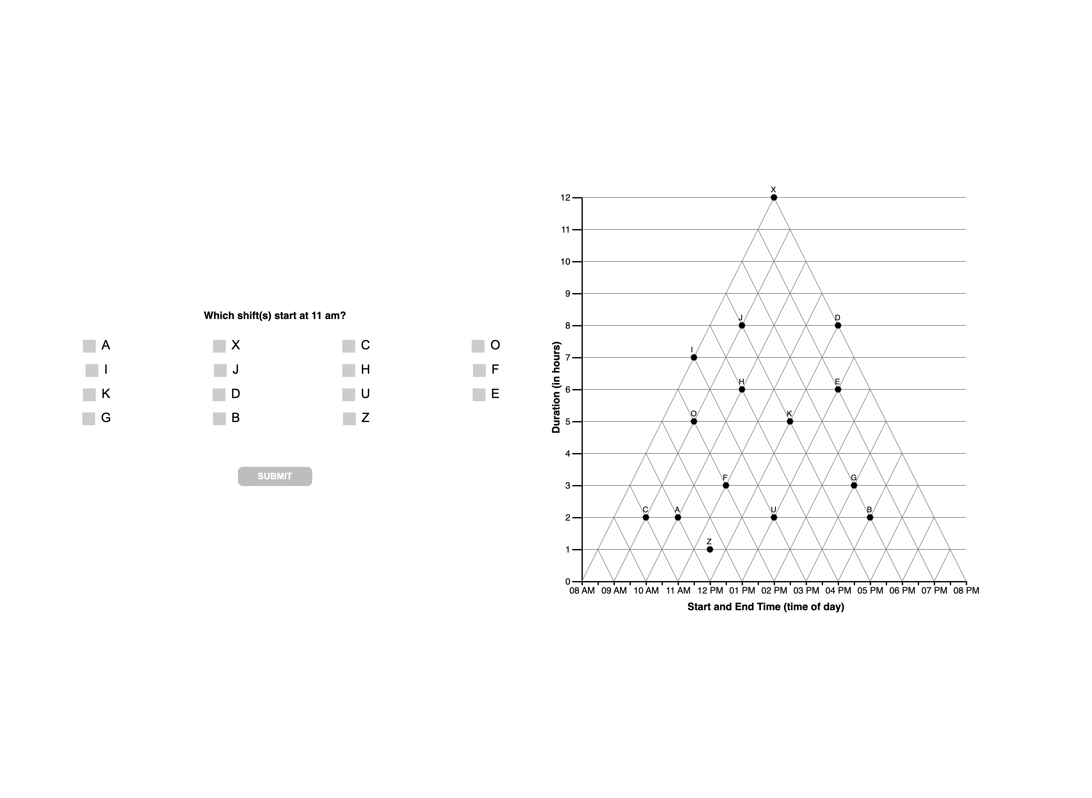

Slide 4
1
interpretations

Slide 6
1
unknown

Slide 8
2
question

Slide 9
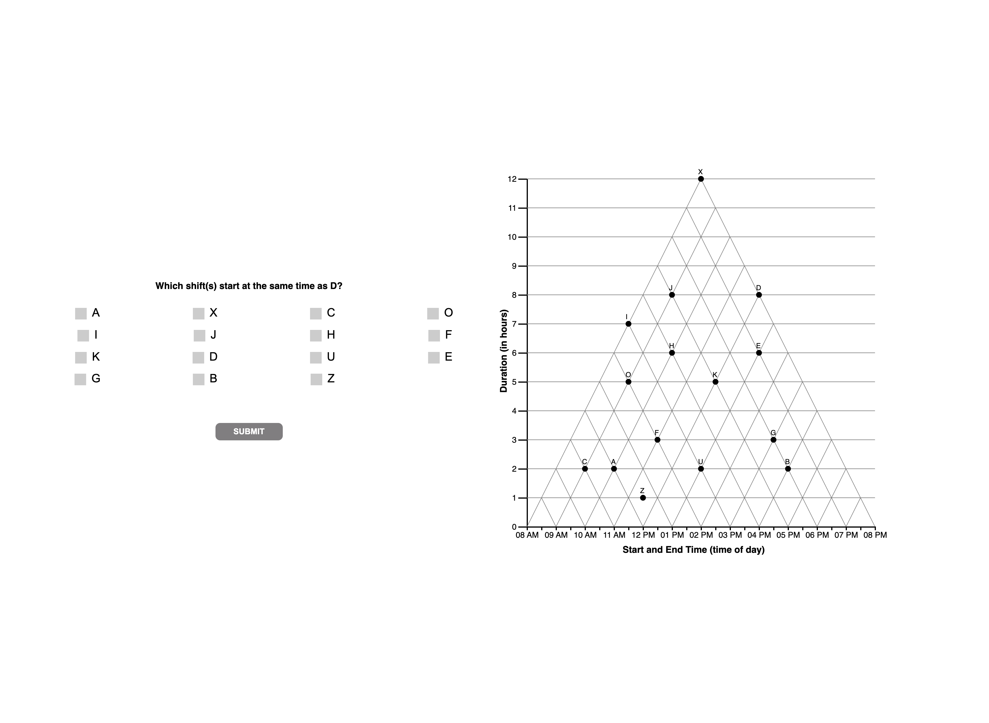

Slide 10
2
interpretations

Slide 12
2
unknown

Slide 15
3
question

Slide 16


Slide 17
3
interpretations

Slide 19
3
unknown

Slide 20
DISTRACTOR?
N = 18
Why is classified as ?

Slide 27
4
question

Slide 28


Slide 29
4
interpretations

Slide 31
4
unknown

Slide 33
D, DE, E | N = 14 + 6 + 1
Reclassify as satisficing!
0 | N = 2
Reclassify as satisficing!

Slide 34
5
question

Slide 35
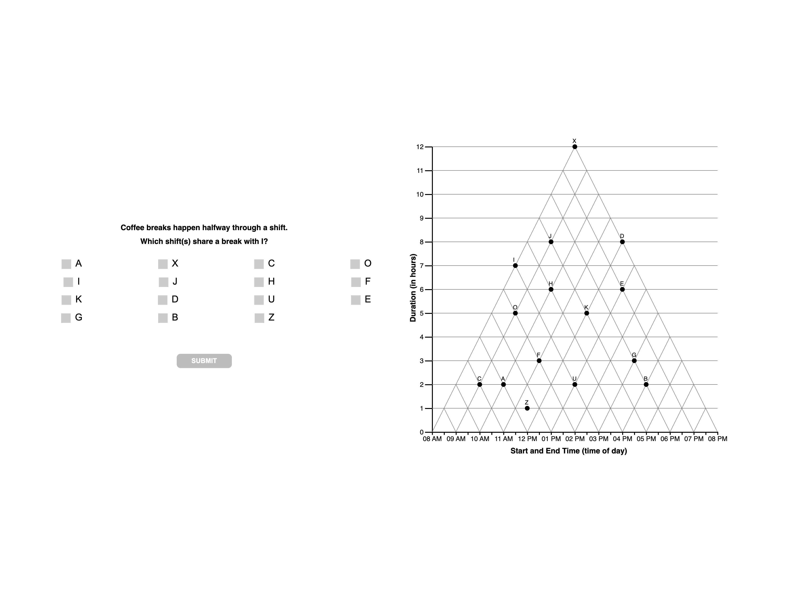

Slide 36
5
interpretations

Slide 38
5
unknown

Slide 40
F | N = 10… classify as VE?/satisfice?
H = 3 … classify as VE?
JH good example of wm overload?

